Slide 1
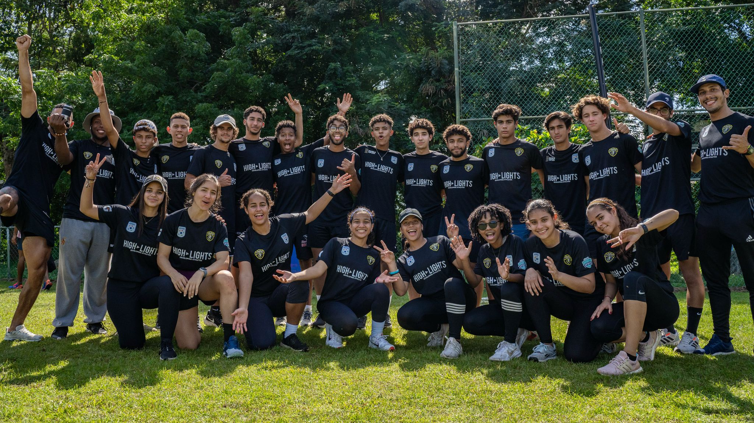
Highlights Post Game Chronicles

Slide 2
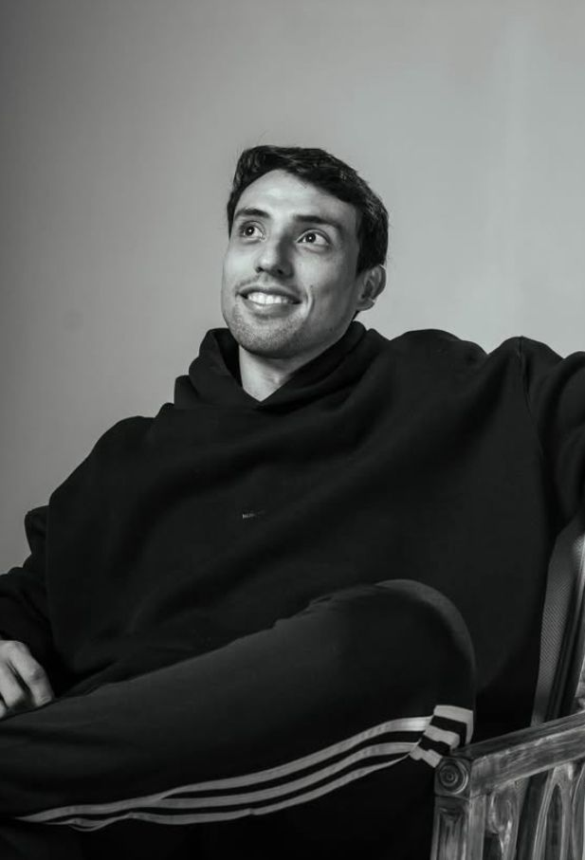
Presenting Sebastian Ballesteros (CEO OF HIGHLIGHTS)
The video start off with Sebastian questioning Ale Montero, Tell me one aspect of the game you did good at and one that you didn’t do good at all. He also ask the same Question to Enrique Linares, Both part of the Highlights Program.
Sebastian, acting as a leader, asks thoughtful questions that promote accountability and honest self-assessment—key virtues in both sports and life. His leadership mirrors the kind of character-driven mentoring described in the original text.

Slide 3
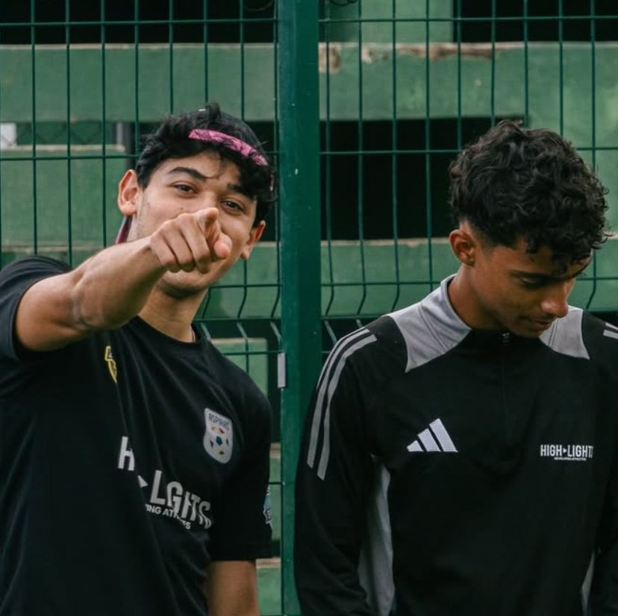
Ale and Enrique
Ale Montero and Enrique Linares, by evaluating both their strengths and weaknesses, demonstrate humility, courage, and a growth mindset—virtues that Virtue Ethics prizes. Rather than hiding from failure or focusing only on success, they embrace a balanced, honest view—like Aristotle's “golden mean.”

Slide 4
The practice of self-reflection after action—a coach-like method shown by Sebastian—is a real-life example of the line from the text:
“I question not only 'What's the most efficient answer?' but also ‘What would a just and caring person do in this situation?'”

Slide 5
Overall, the interaction in the video shows how young athletes at Aspiras Academy are building moral character through sports—living out the exact principles of Virtue Ethics: becoming better not just at what they do, but at who they are.

Slide 6
Work cited
Highlights DR
https://plato.stanford.edu/entries/ethics-virtue/Links to an external site.
Living and Working Using Virtue Ethics

